Slide 1
The pale blue dot

Slide 2
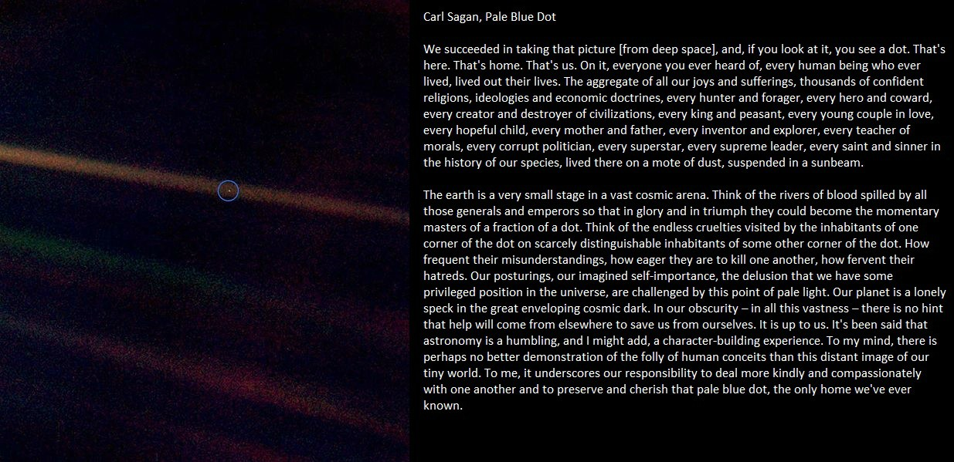
Audio File

Slide 3
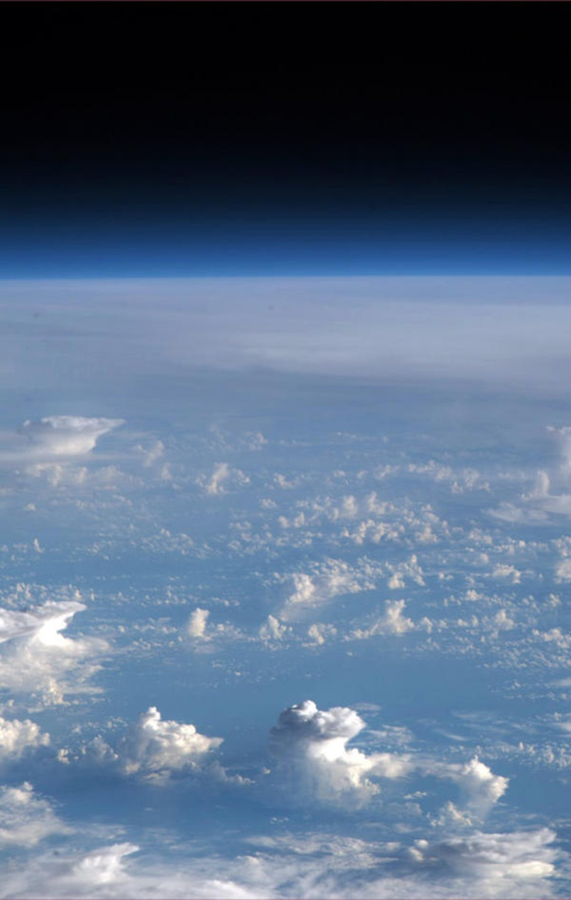

Slide 4
The pale blue dot
On Dec 19, 2012, a man started sharing with the world the beauty of the Earth system.
Quirks and Quarks, October 25, 2014

Slide 5
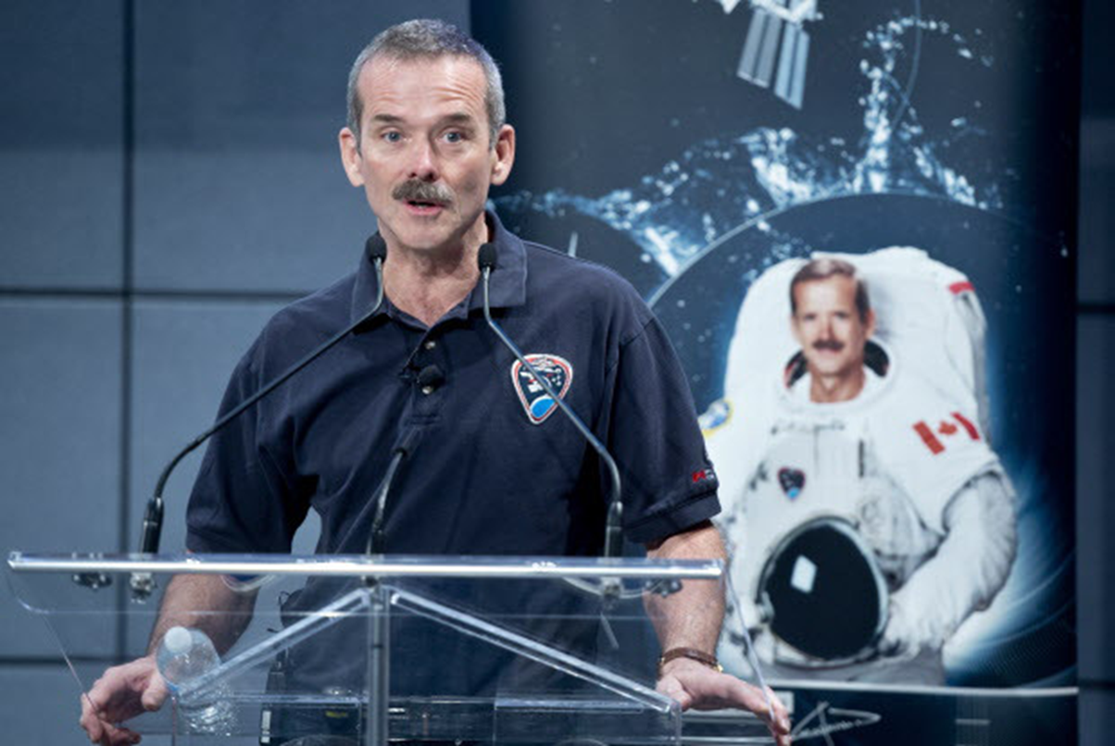
The pale blue dot
Longeuil, Quebec - Chris Hadfield speaking at a news conference, 2013

Slide 6
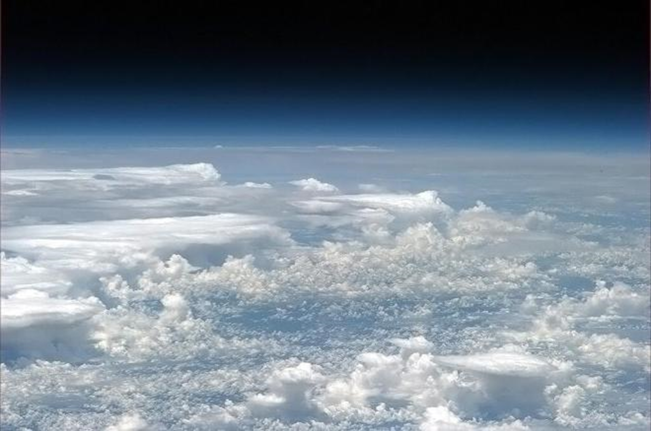
The pale blue dot
Atmospheric clouds (Hadfield, 2013)

Slide 7
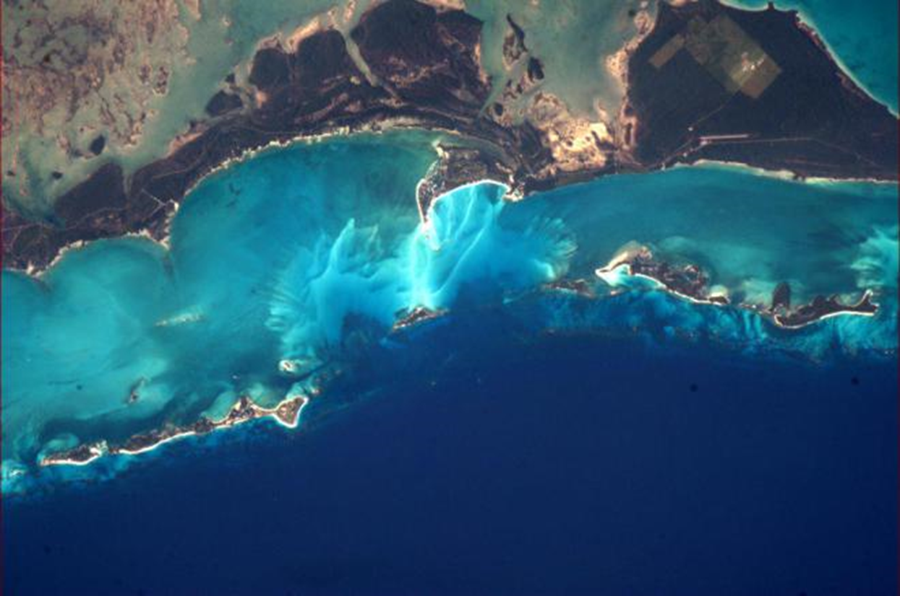
The pale blue dot
Bahamas – the colours from space (Hadfield, 2013)

Slide 8
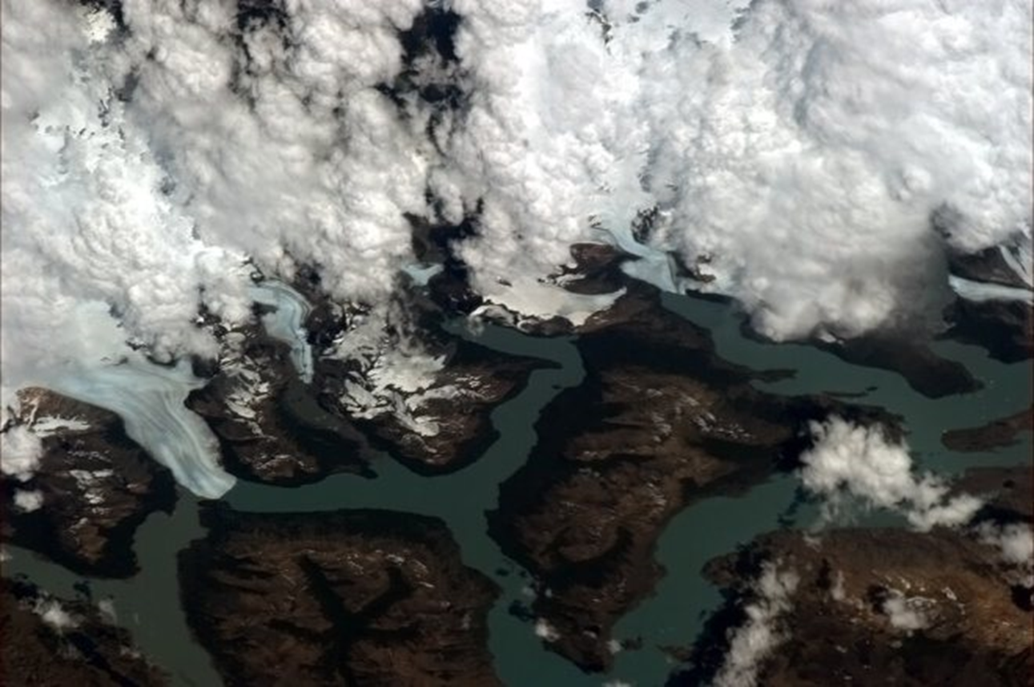
The pale blue dot
South America – cloud, ice and rock (Hadfield, 2013)

Slide 9
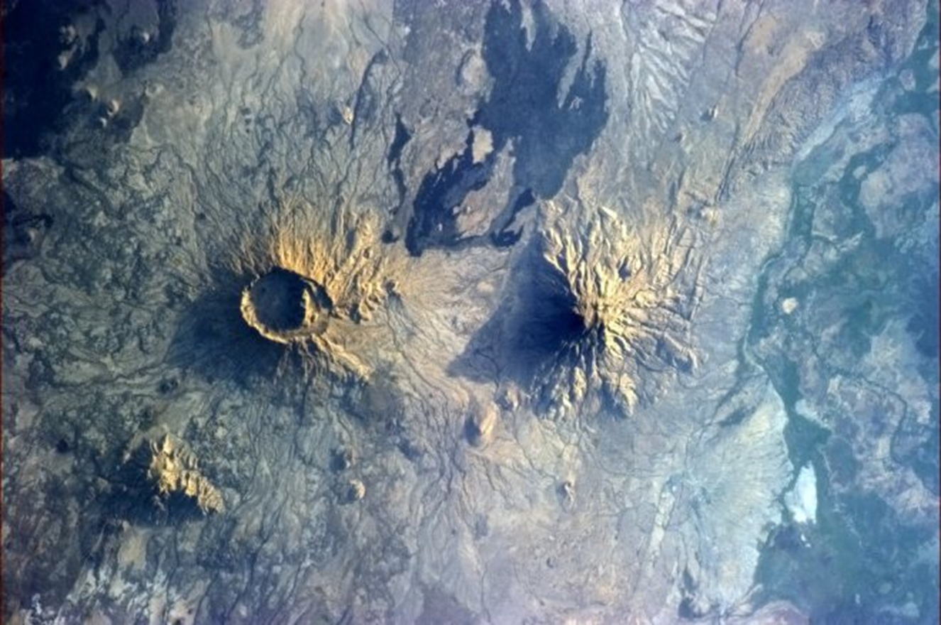
The pale blue dot
Volcanoes (Hadfield, 2013)

Slide 10
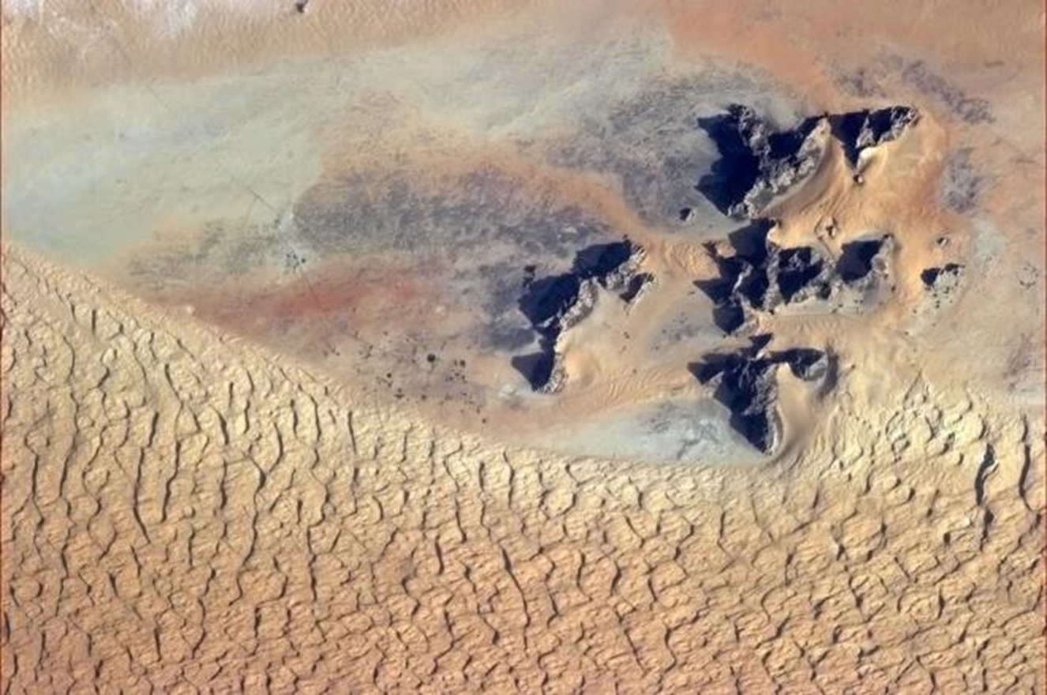
The pale blue dot
Saudi Arabia (Hadfield, 2013)

Slide 11
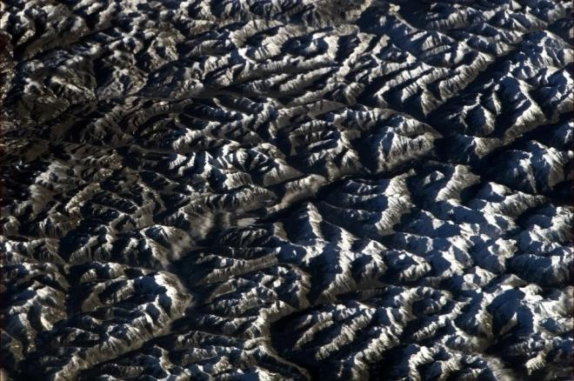
The pale blue dot
The Rockies (Hadfield, 2012)

Slide 12
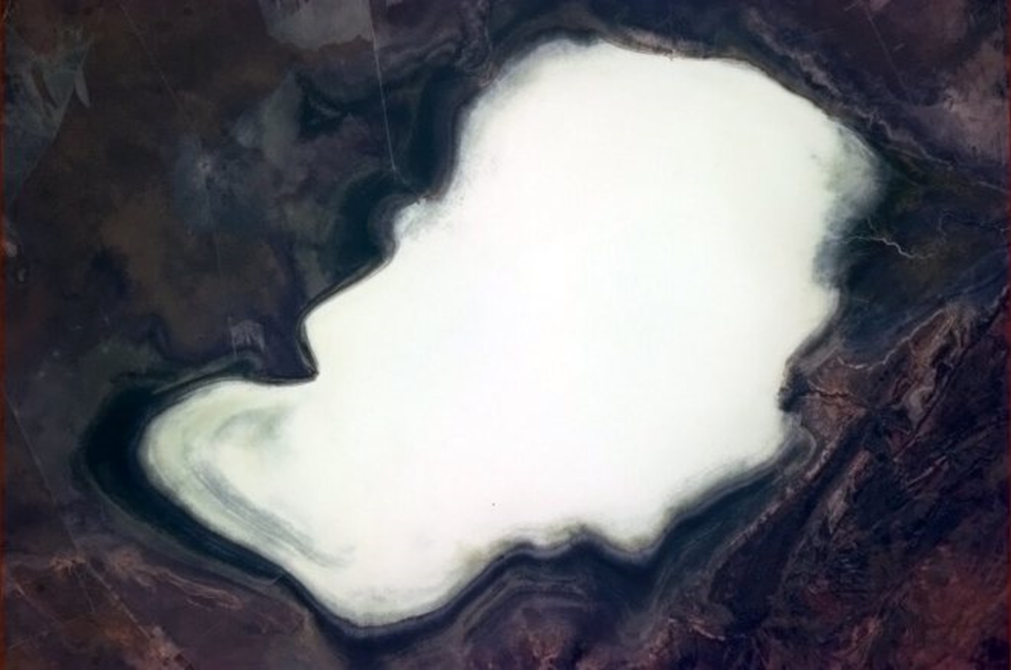
The pale blue dot
Australia – dry salt lake, in the Outback (Hadfield, 2013)

Slide 13
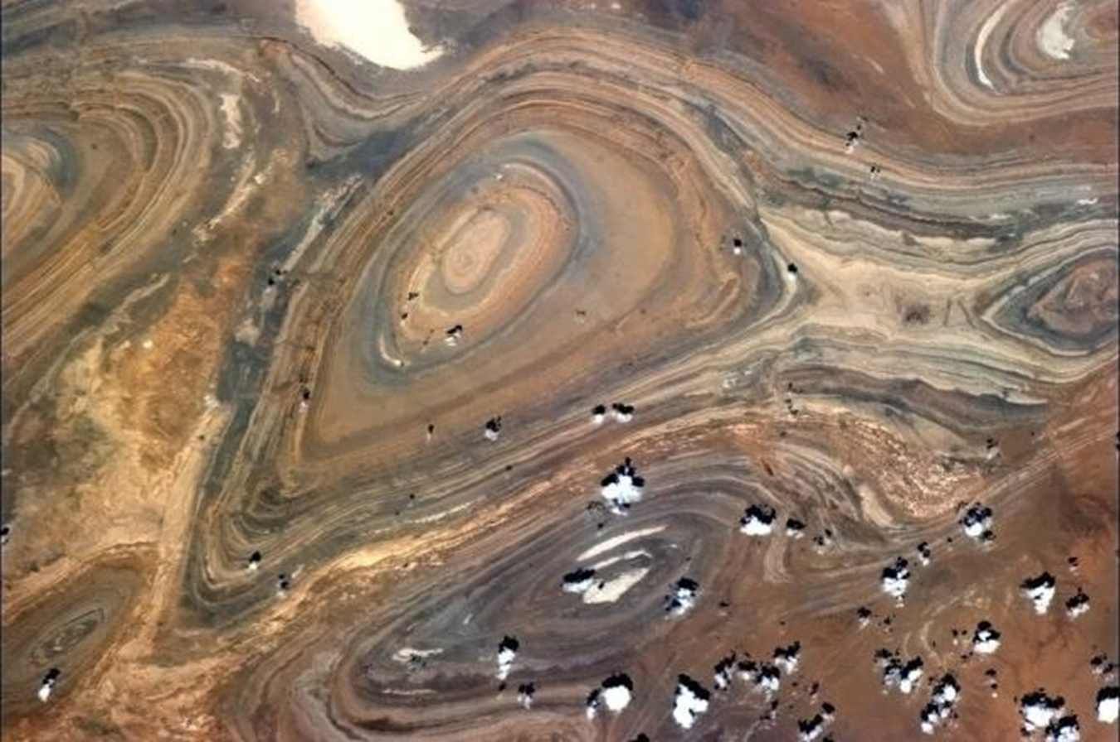
The pale blue dot
The Sahara Desert – ancient stone burnished by sand and wind (Hadfield, 2013)

Slide 14
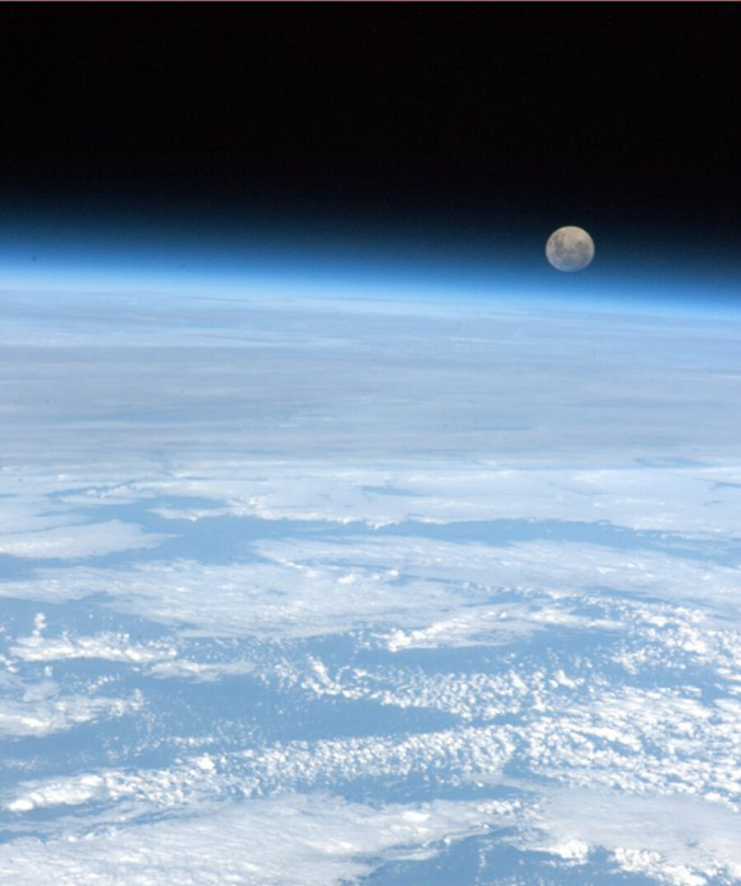
The pale blue dot
Moon rise over earth (Hadfield, 2013)

Slide 15
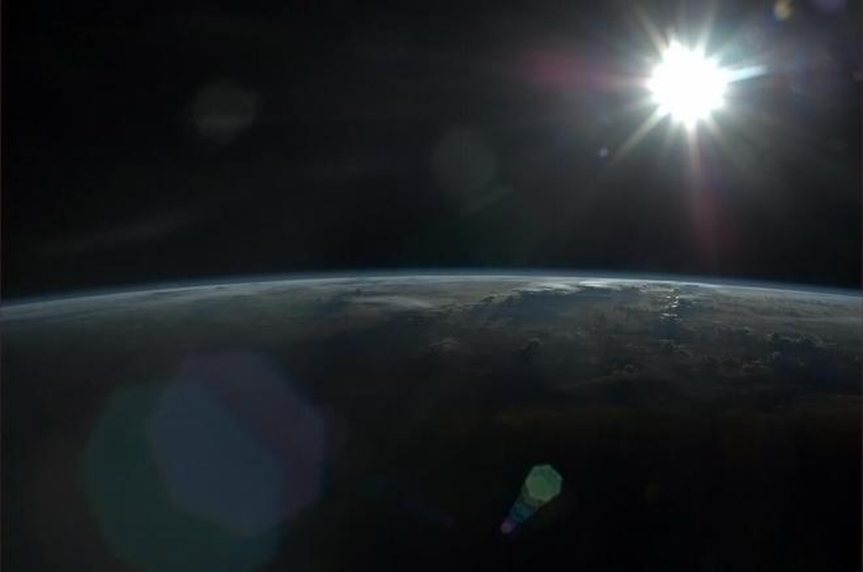
The pale blue dot
The sun rising over the Earth (Hadfield, 2013)

Slide 16
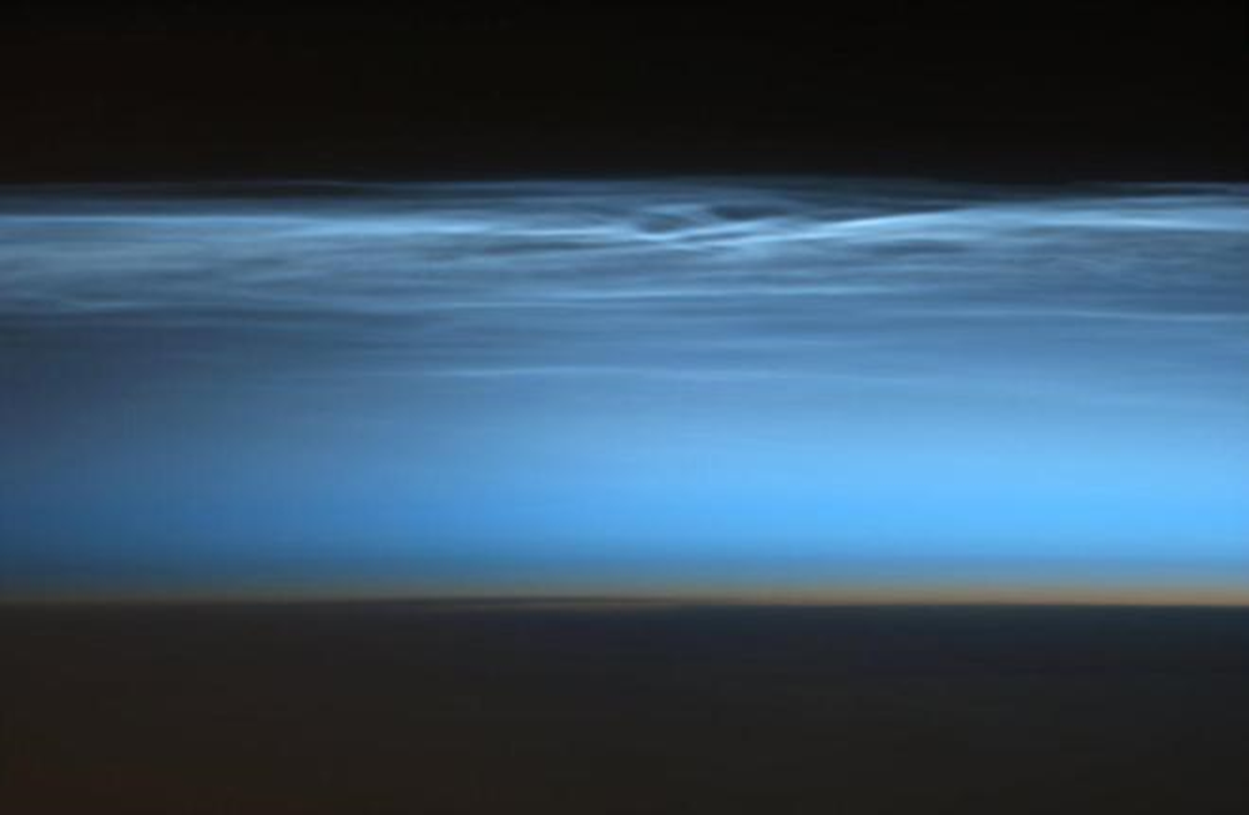
The pale blue dot
Noctilucent Cloud – the Mesosphere (Hadfield, 2013)

Slide 17
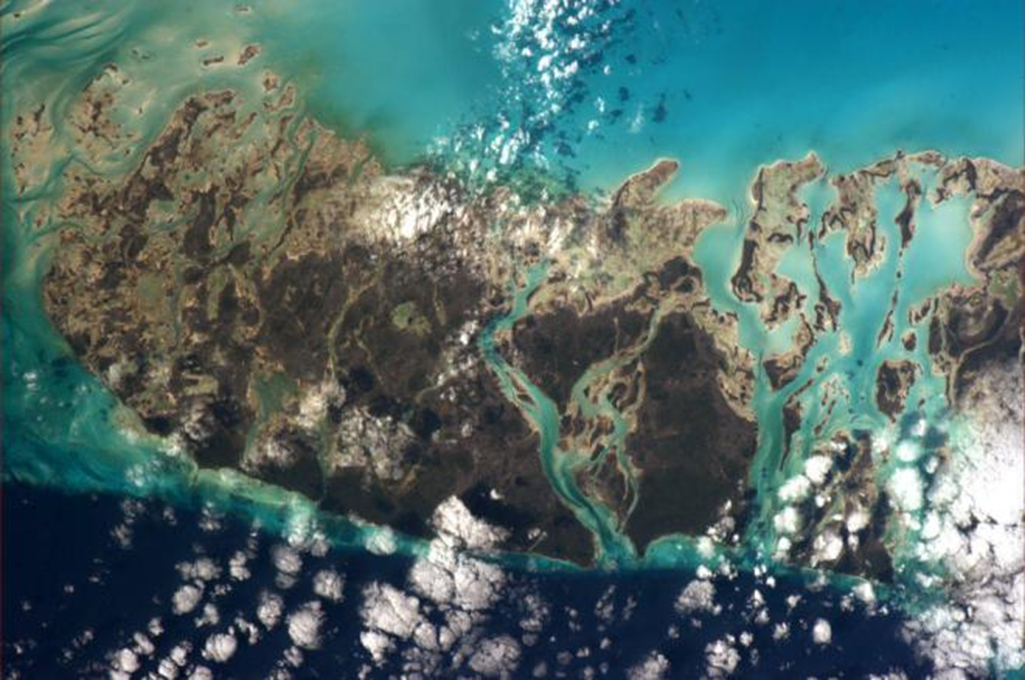
The pale blue dot
Andros Island, Bahamas (Hadfield, 2013)

Slide 18
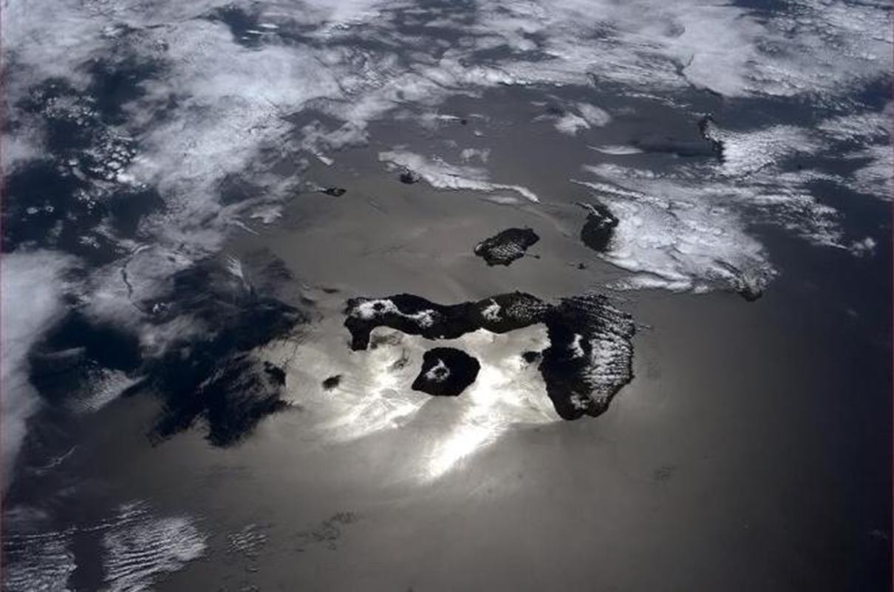
The pale blue dot
The Galapagos (Hadfield, 2013)

Slide 19
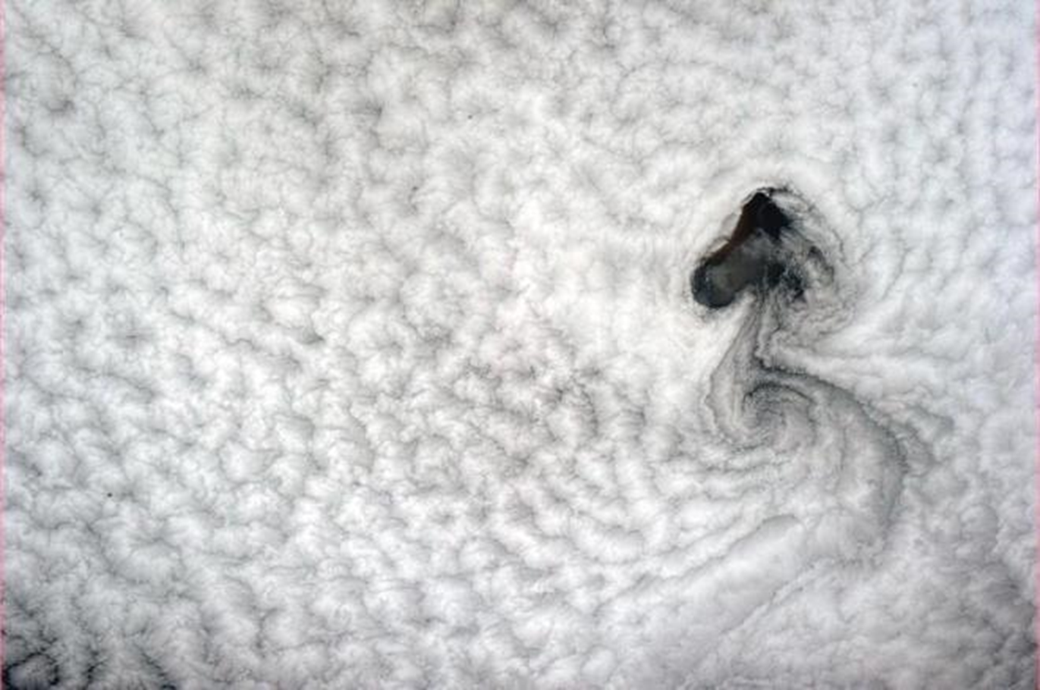
The pale blue dot
Clouds over the Pacific (Hadfield, 2013)

Slide 20
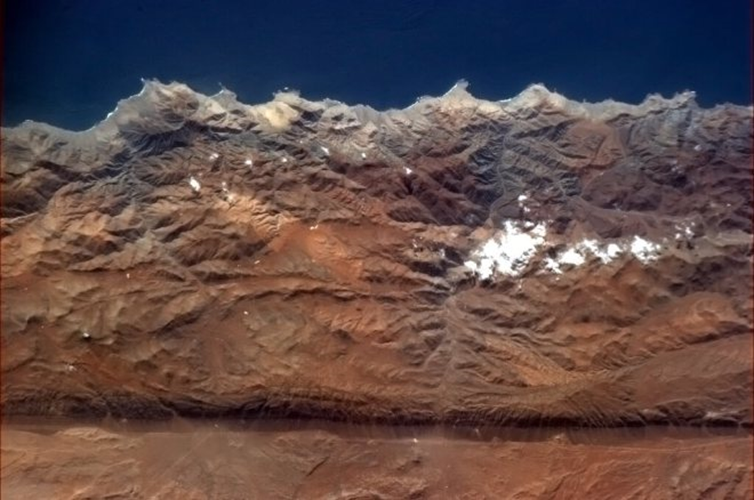
The pale blue dot
Andes Mountains - spot the fault line (Hadfield, 2013)

Slide 21
The pale blue dot
In this vast beauty, there is evidence of the impact of human activity on the natural environment.

Slide 22
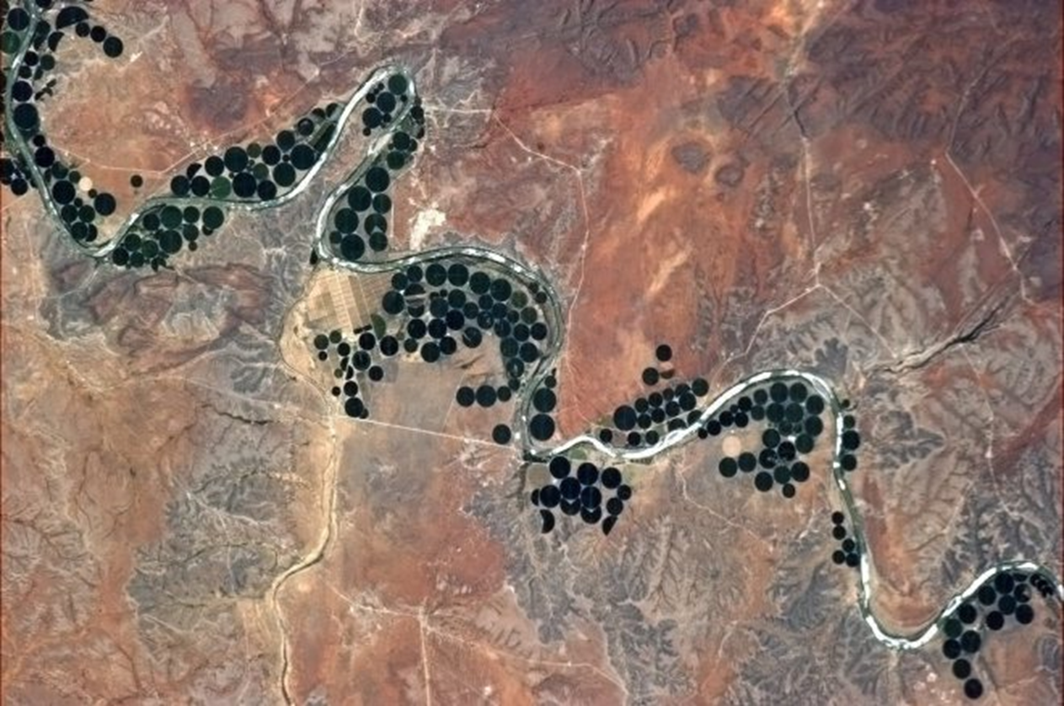
The pale blue dot
South Africa – serpentine river and centre-pivot irrigation (Hadfield, 2013)

Slide 23
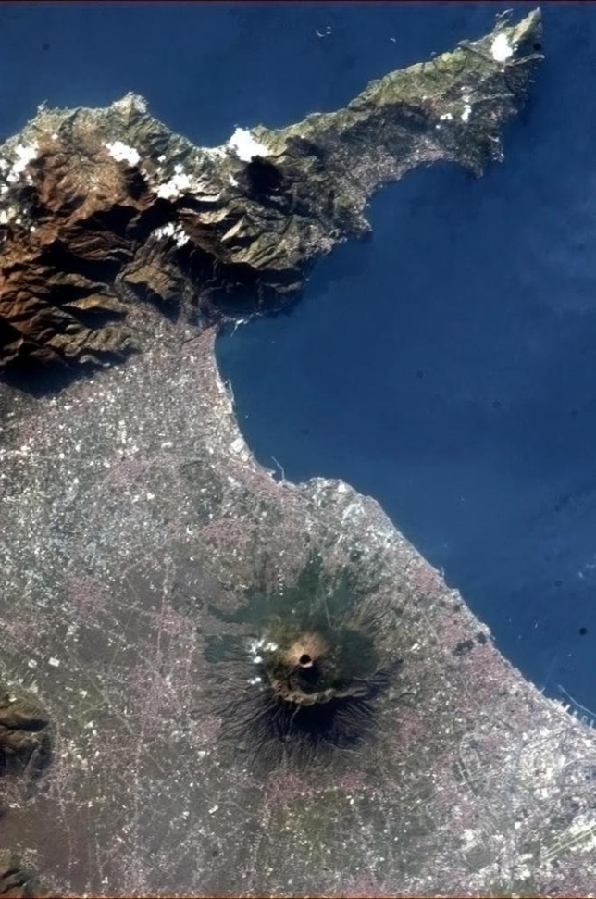
The pale blue dot
Mount Vesuvius, Italy (Hadfield, 2013)

Slide 24
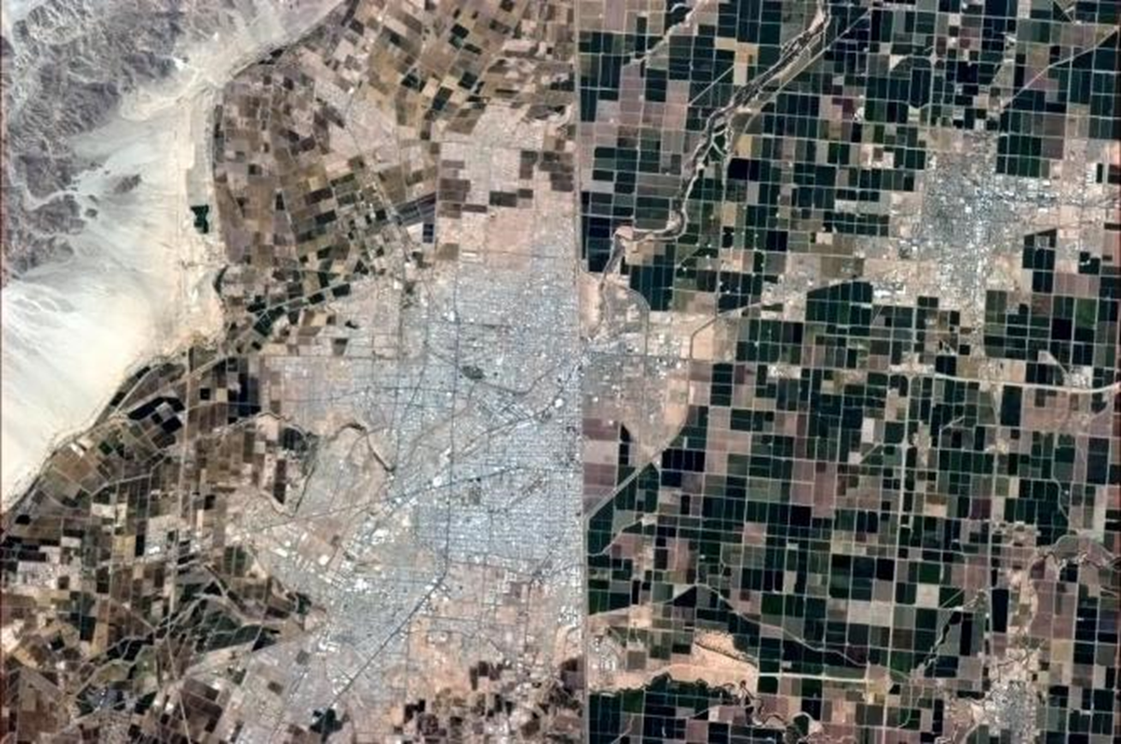
The pale blue dot
The Mexico-US border (Hadfield, 2013)

Slide 25
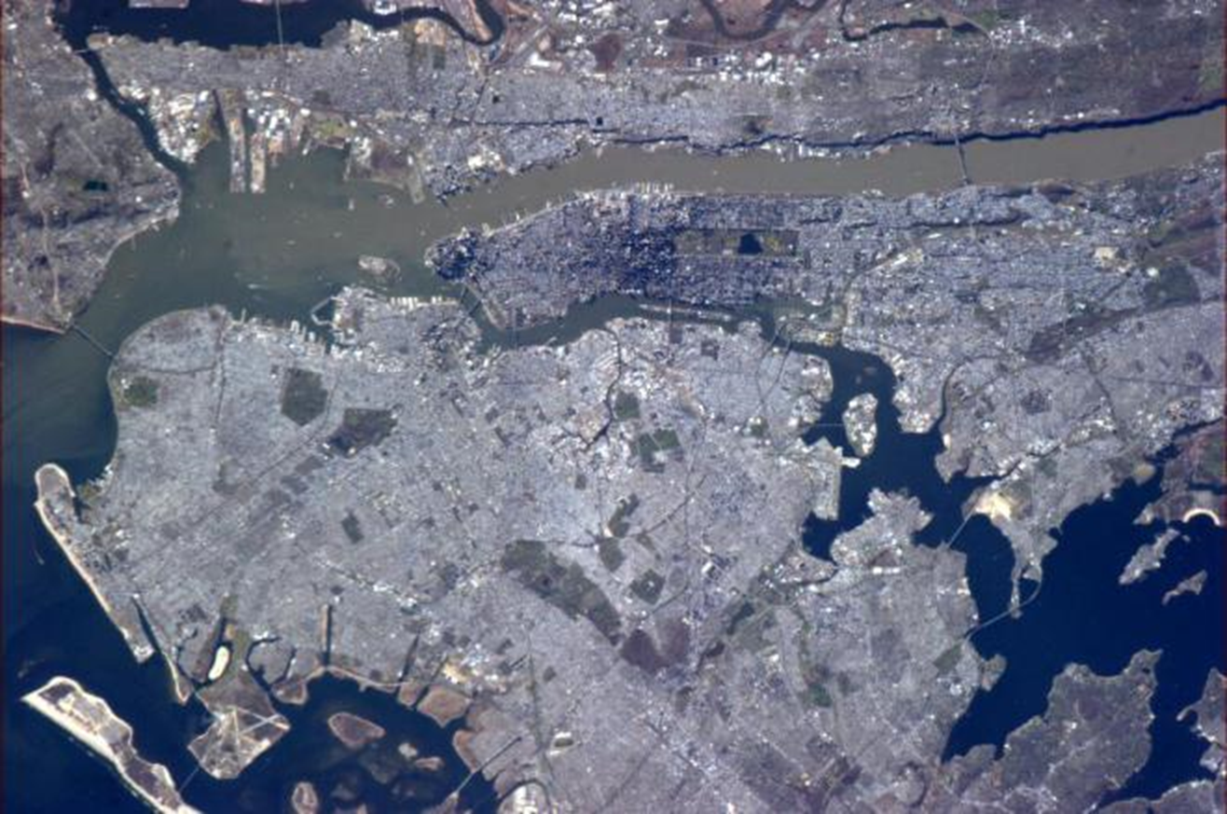
The pale blue dot
New York City, USA–spring. (Hadfield, 2013)

Slide 26
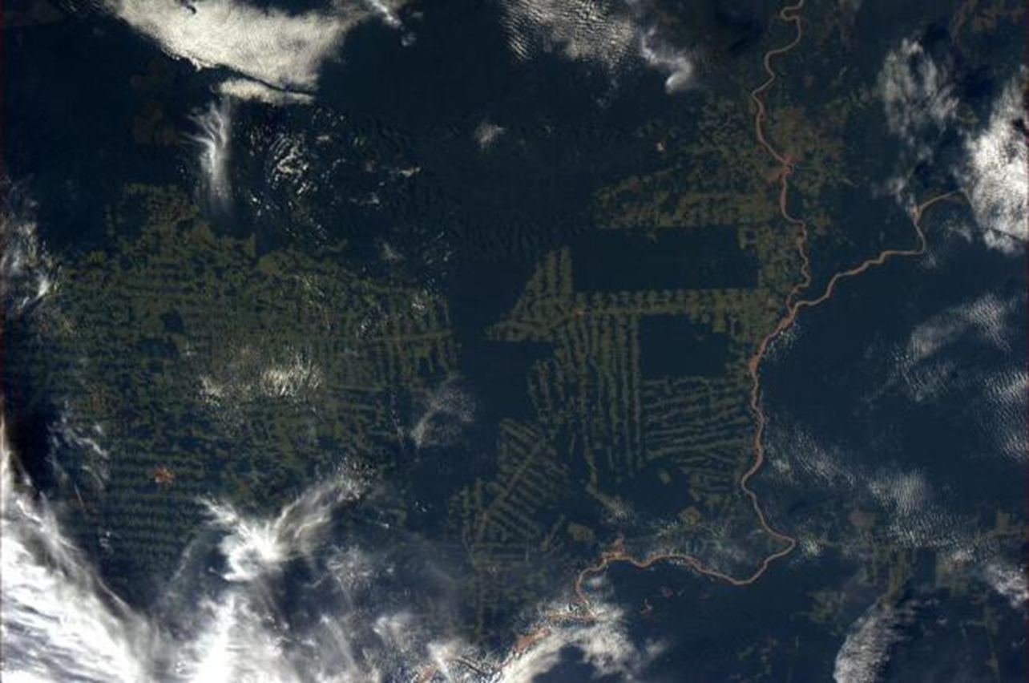
The pale blue dot
The Amazon Forest, Brazil – forest clearing for terraforming (Hadfield, 2013)

Slide 27
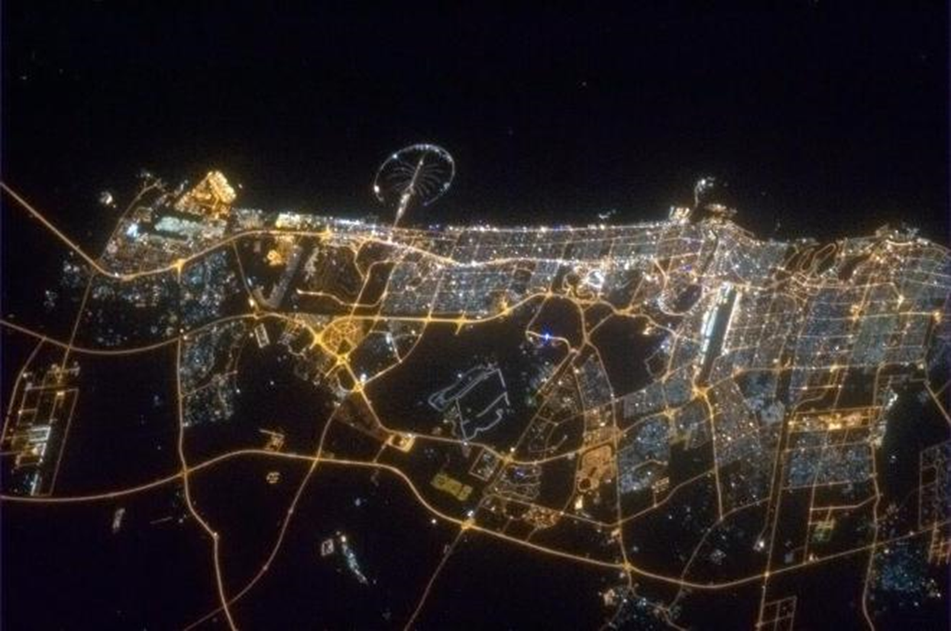
The pale blue dot
Dubai, United Arab Emirates – palm island at the top of the photo (Hadfield, 2013)

Slide 28
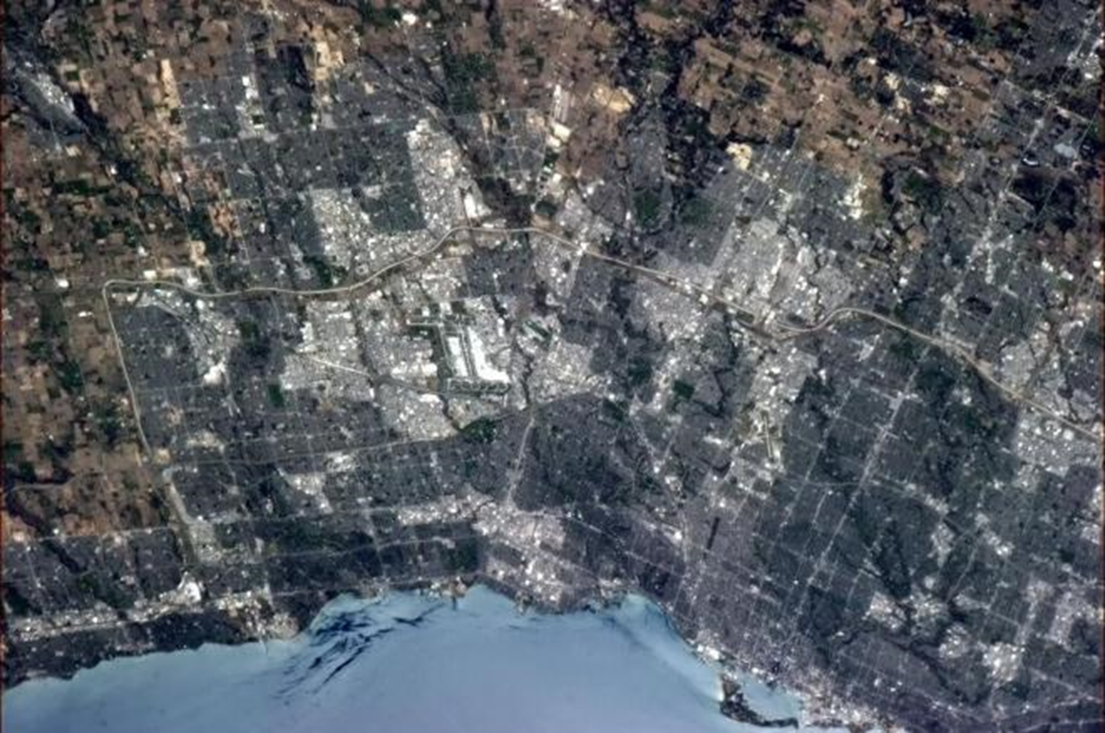
The pale blue dot
Toronto (Hadfield, 2013)

Slide 29
The pale blue dot
Are we doing enough to protect the unique system that is our Earth?

Slide 30
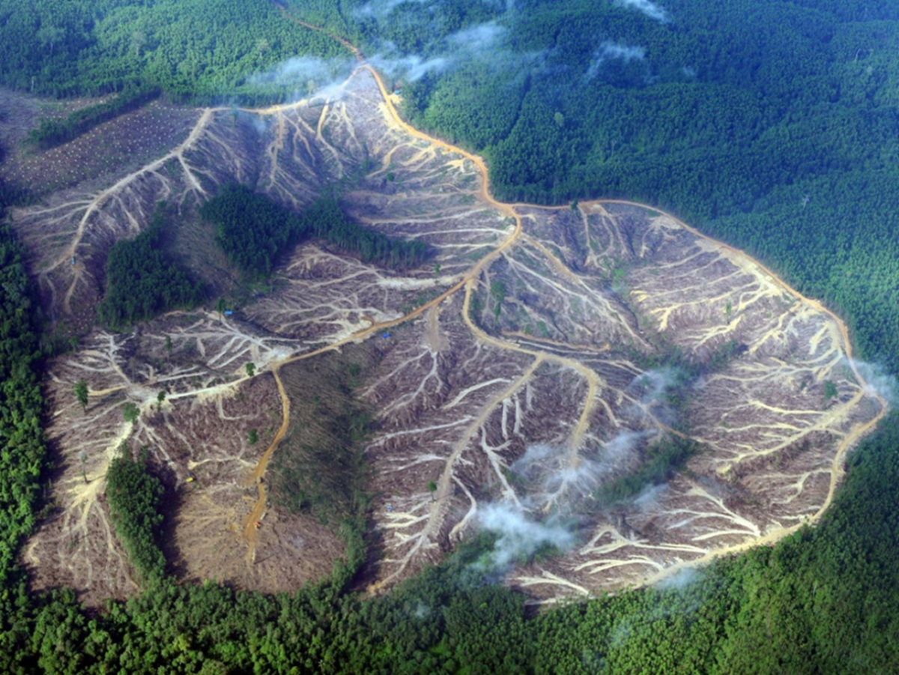
The pale blue dot
Sumatra, Indonesia – forest clearing for palm oil plantations (AFP/Getty Romeo Gacad/AFP/Getty Images, 2013)

Slide 31
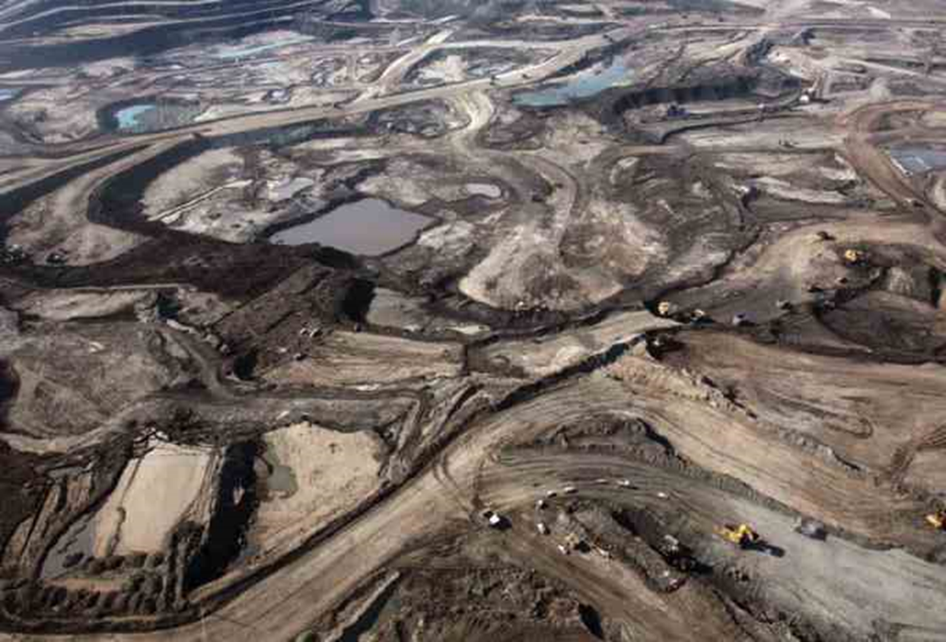
The pale blue dot
Alberta, Canada – forest clearing for oil sands development (Alberta Oil Sands Jobs, 2015)

Slide 32
The pale blue dot
Alberta, Canada – Boreal Forest (Canadian Parks and Wilderness Society, 2011)

Slide 33
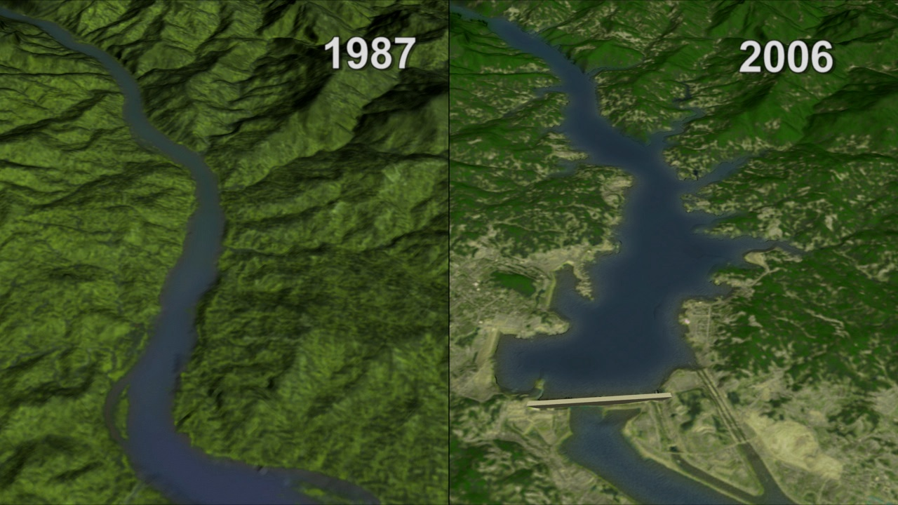
The pale blue dot
China – Landscape at the site of the Three Gorges Dam before (left) and after (right) construction (NASA, 2007)

Slide 34
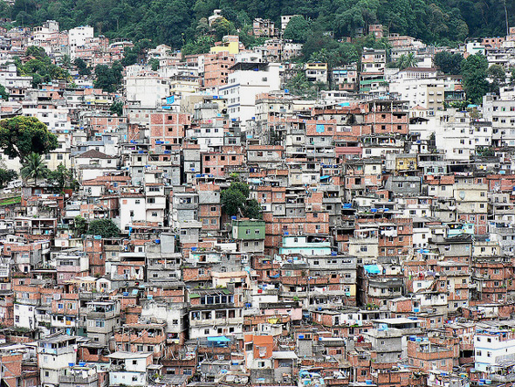
The pale blue dot
Urbanization (Environmental Change and Security Program, 2012)

Slide 35
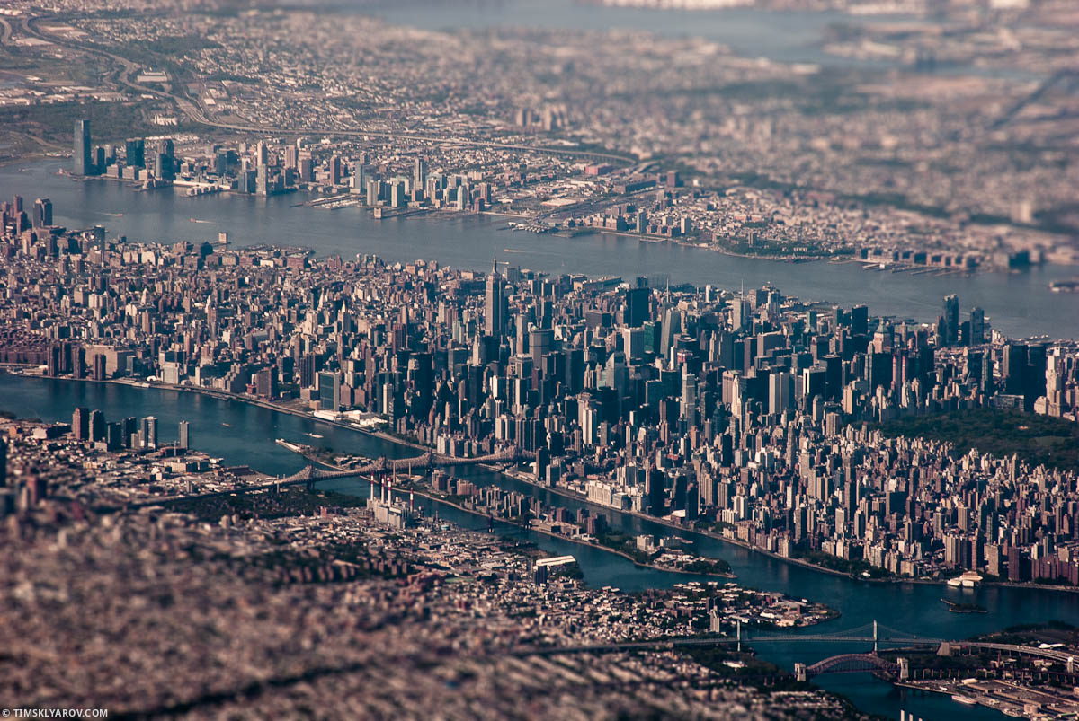
The pale blue dot
New York City, USA – urbanization (Sklyarov, 2012)

Slide 36
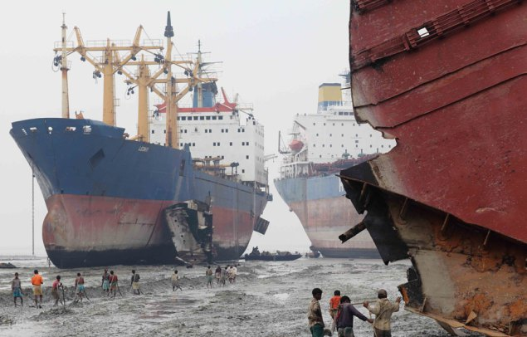
The pale blue dot
Shipbreaking – India (gCaptain, 2012)

Slide 37
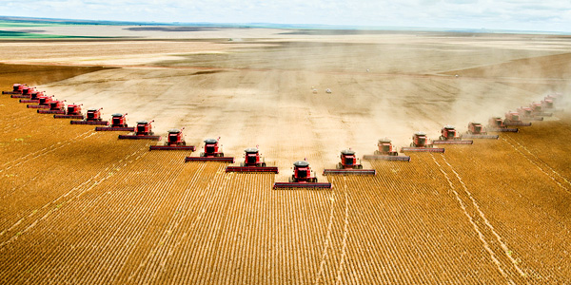
The pale blue dot
Industrial Agriculture (Underwood Gardens, 2011)

Slide 38
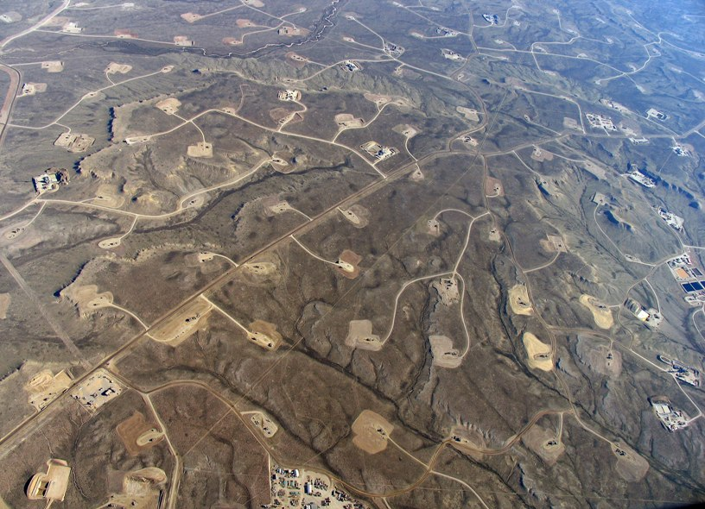
The pale blue dot
Fracking wells, western United States (Greenpeace, 2015)

Slide 39
The pale blue dot
What should we be doing to preserve a healthy environment?

Slide 40
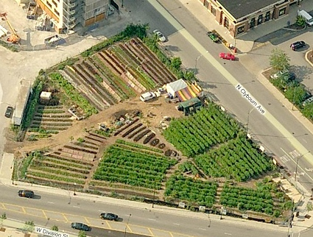
The pale blue dot
Urban agriculture, Chicago City Farm, Chicago, USA (City Farmer, 2009)

Slide 41
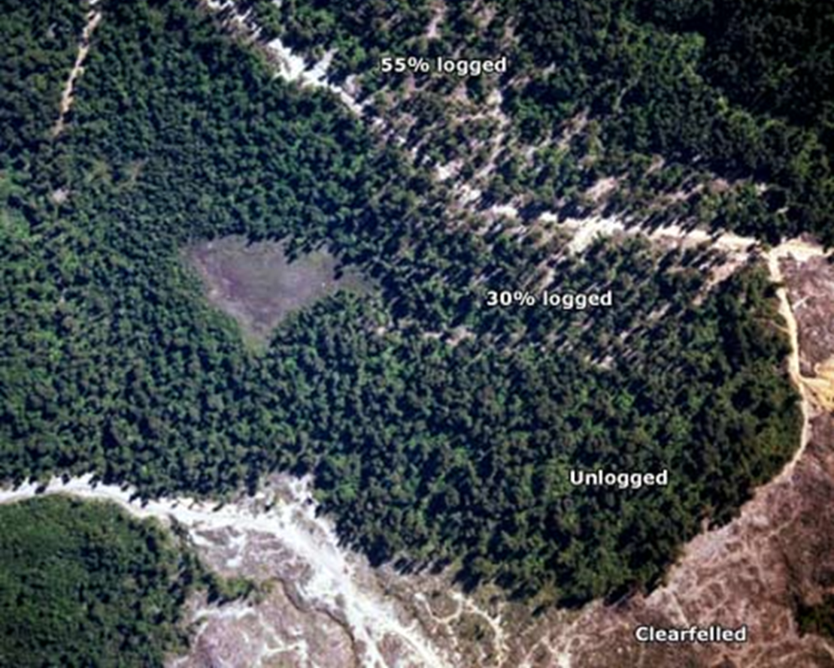
The pale blue dot
Alternative logging practices (McGreevy, TeAra, The Encyclopedia of New Zealand 2013)

Slide 42
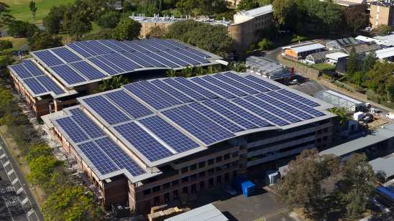
The pale blue dot
Rooftop solar panels, Australia (Reneweconomy, 2014)

